Slide 1
GOOGLE APP ENGINE

Slide 2
INTRODUCTION
Google App Engine is a platform as a service(Paas)offering that lets you build and run applications on google’s infrastructure.App engine applications are easy to build,easy to maintain and easy to scale as our traffic and data storage needs change. With App Engine,there are no servers for us to maintain.We simply upload our application and its ready to go.

Slide 3
FEATURES OF GOOGLE APP ENGINE
The Google app Engine can be divided into three parts:
Runtime Environment: Itself presents as the place where the actual application is executed.
Persistence and the datastore: The stateless execution of applications creates the need for a datastore that provides a proper way for persistence.
Services: Abstraction are implemented as a services that can be directly called from the actual application.

Slide 4
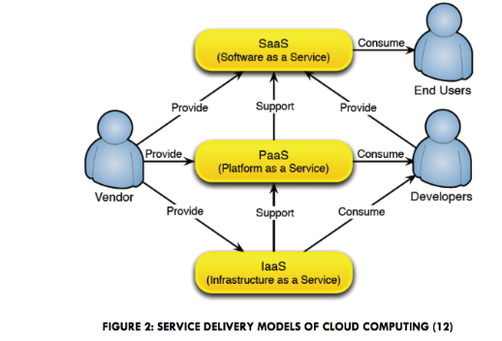
SERVICE DELIVERY MODELS

Slide 5
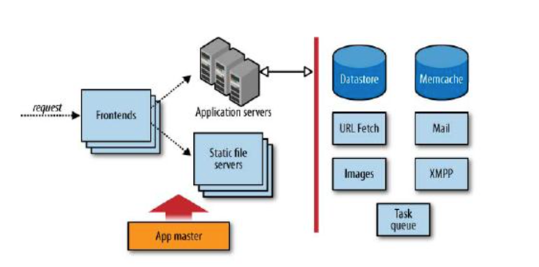
STRUCTURE OF GOOGLE APP ENGINE

Slide 6
APPLICATION DEVELOPMENT USING GOOGLE APP ENGINE
General idea:
Inorder to evaluate the flexibility and scalability of the GAE we tried to come up with an application that relies heavily on scalability.
Requirements and functionality
Implementation:
Development Environment
Application Environment

Slide 7
PROPOSED SYSTEM
Easy to build,maintain and easy to scale
No need of server to maintain
It can be used to build mobile and social applications,traditionalweb browser-based applications,standalone web services or offline batch processing.
GAE services enables users to build and host web apps on the same computing infrastructure that powers Google applications.

Slide 8
ADVANTAGES FOR THE SOFTWARE DEVELOPER
Service-oriented distributed computing will emerge as a factor in shaping the industry.
Changing the way business is conducted and how services are delivered and managed.
Cloud computing opens up exciting new possibilities based on a mix of old and new technologies for the next generation of software developers.

Slide 9
SOFTWARE ENGINEERING ASPECTS
Functional aspects:
PaaS environments set certain restrictions to the developer in terms of programming techniques,languages and other elsewhere available functionality.
Usability:
GAE offers easy access to the domain of Cloud Computing by providing abstractions for important services such as persistence as well as an easy to use development environment.

Slide 10
Continue..
Scalability:
Instead of running an application on more powerful hardware,the application is executed on more instances of less powerful hardware.
Integration:
It will bring a new form of cloud service,that is cloud integration service.
Availability:
A high availability architecture is adopted and both the platform and applications are fully tested.

Slide 11
Continue….
Support:
Cloud services should be designed for easier usability.
Privacy:
Current privacy concepts such as the fair information principles may face damage to their reputation.

Slide 12
CONCLUSION
Our evaluation of the Google App engine has shown both functionality and limitations of the platform.
Developing and deploying an application within the GAE is in fact quite easy and in a way shows the progress shows that software development and deployment has made.

